Slide 1
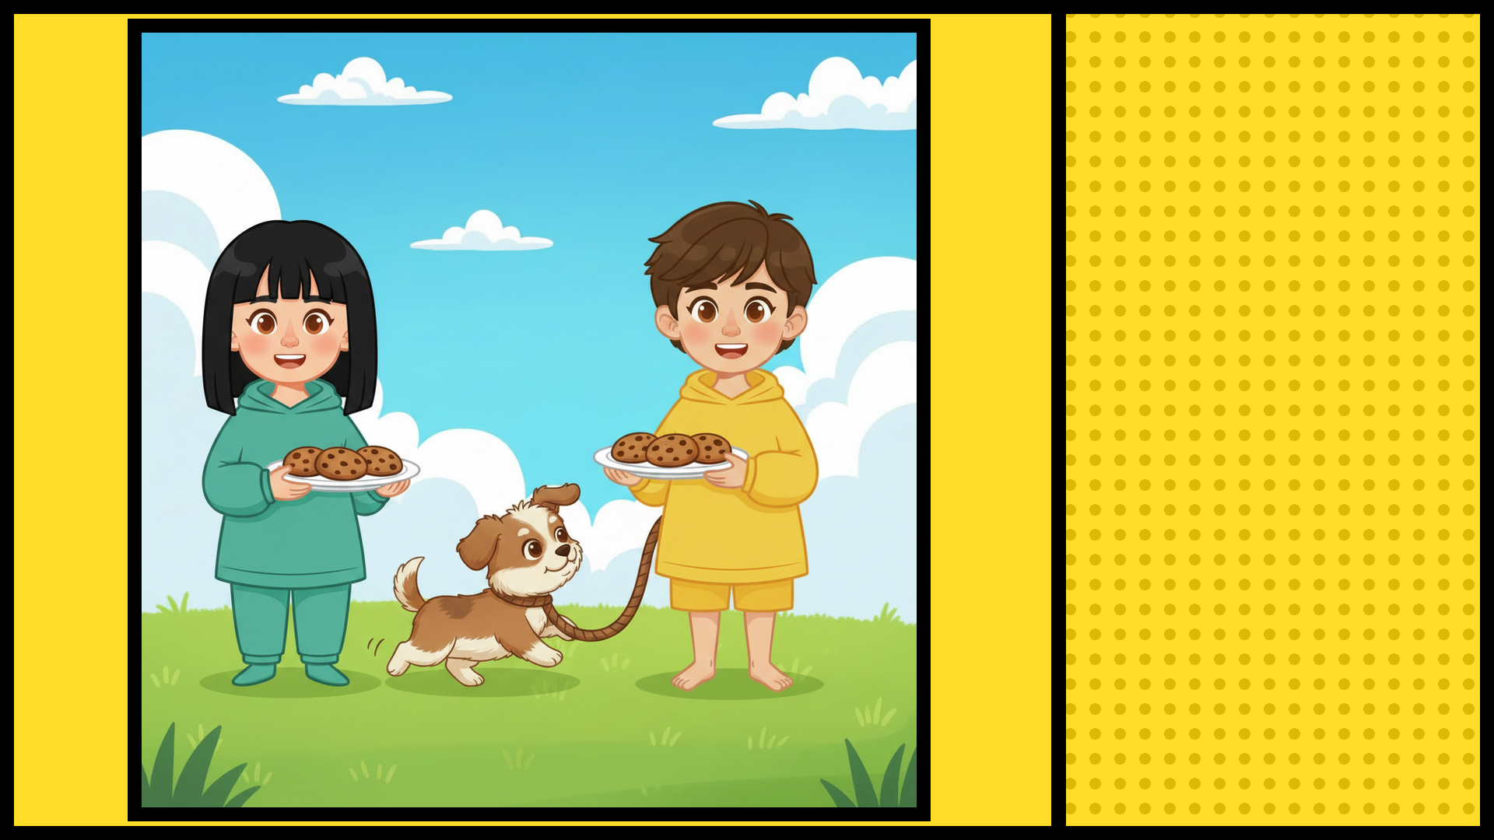
SAM AND ELLA
EACH HAD A PLATE
OF COOKIES

Slide 2
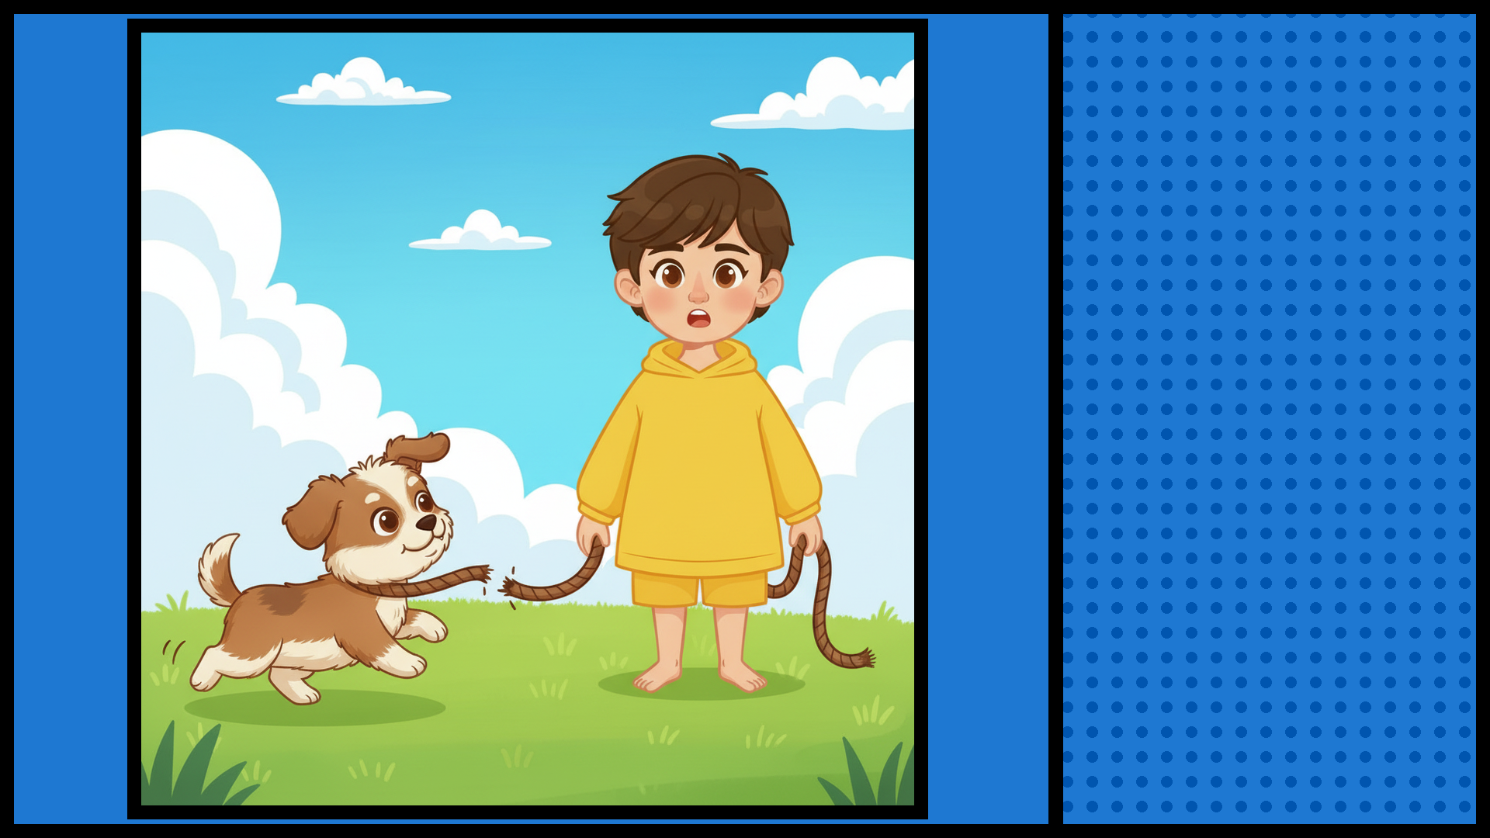
SAM COULDN'T
HOLD THE LEASH!

Slide 3
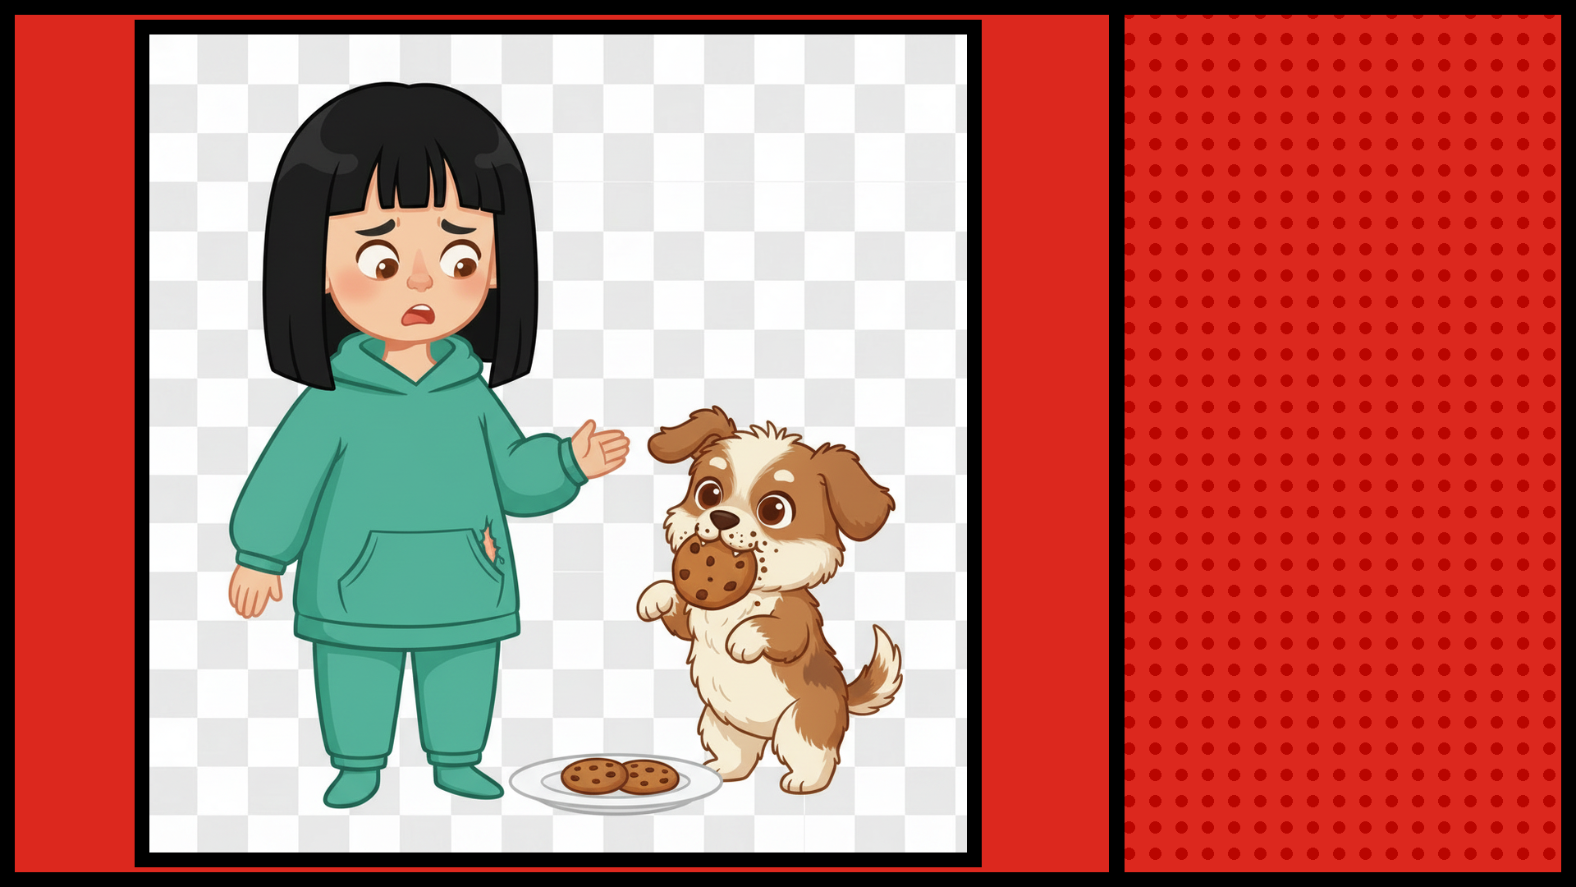
SAM’S DOG ATE
1 of ELLA’S COOKIES!

